Slide 1
Topic : Bus Reservation System Team Members Jatin Pokale(TL) Swarali Shitole Nidhi Jha Sivasankaran

Slide 2
CONTEXT
Introduction
Features of System
Technologies
Functional Requirements
Use Case Diagram/Flow Diagram
Database Diagram
User Interface

Slide 3
Introduction
Online bus reservation system is a project which provides an online portal for bus ticket reservation. This application allows customers to book bus tickets from anywhere and anytime. The customer can easily book and cancel their tickets at their comfort. The customer can view all the details of the seats, bus, and route along with pictures. The customer can also view and download the details of the journey and journey timings. This will give customer an overview of the journey and will be a hassle-free task of doing bus reservation at fingertips..

Slide 4
Features
Convenient method of Bus Reservation.
An Online bus reservation is easy operation.
We can check our status of booking online.
Before booking we can check all details about bus.
Save time.
Its beneficial for both the users and admin.

Slide 5
Technologies
Back End
C#
ASP.NET Web API
Front End
HTML
CSS
Angular

Slide 6
Functional Requirements
Registration
Login
Bus Avaibility Enquiry
Make Reservation
Cancel Reservation
Payments

Slide 7
Use Case Diagram
Login
Bus Availability Enquiry
Make Reservation
User
Cancel Reservation
Print Ticket
Admin
Login
Wallet Payment

Slide 8
Flow Diagram
User
Create Account
Login
Search Bus
Book Seat
Send Email To User
Forgot Password
Admin

Slide 9
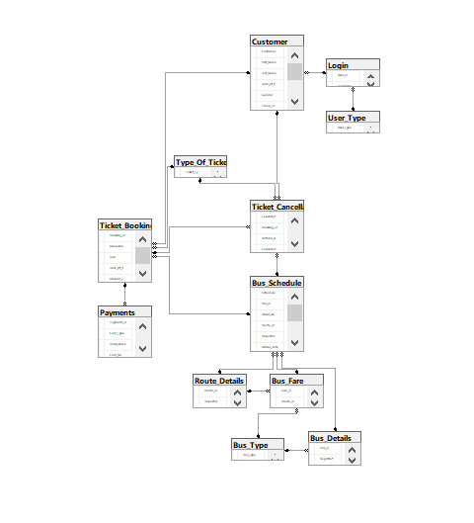
Database Diagram

Slide 10
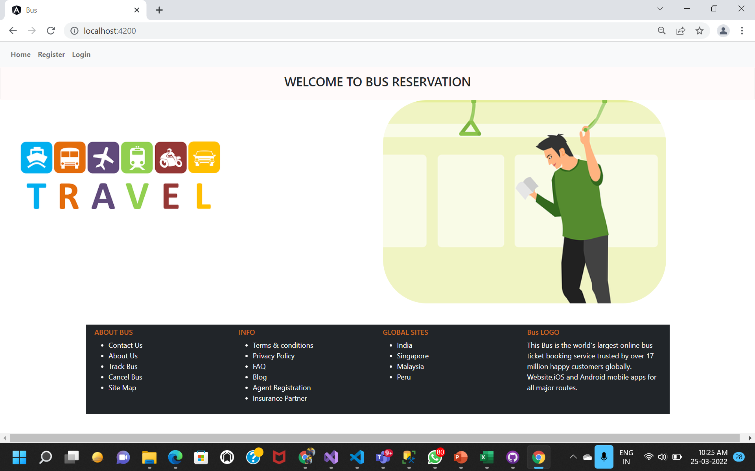
User Interface

Slide 11
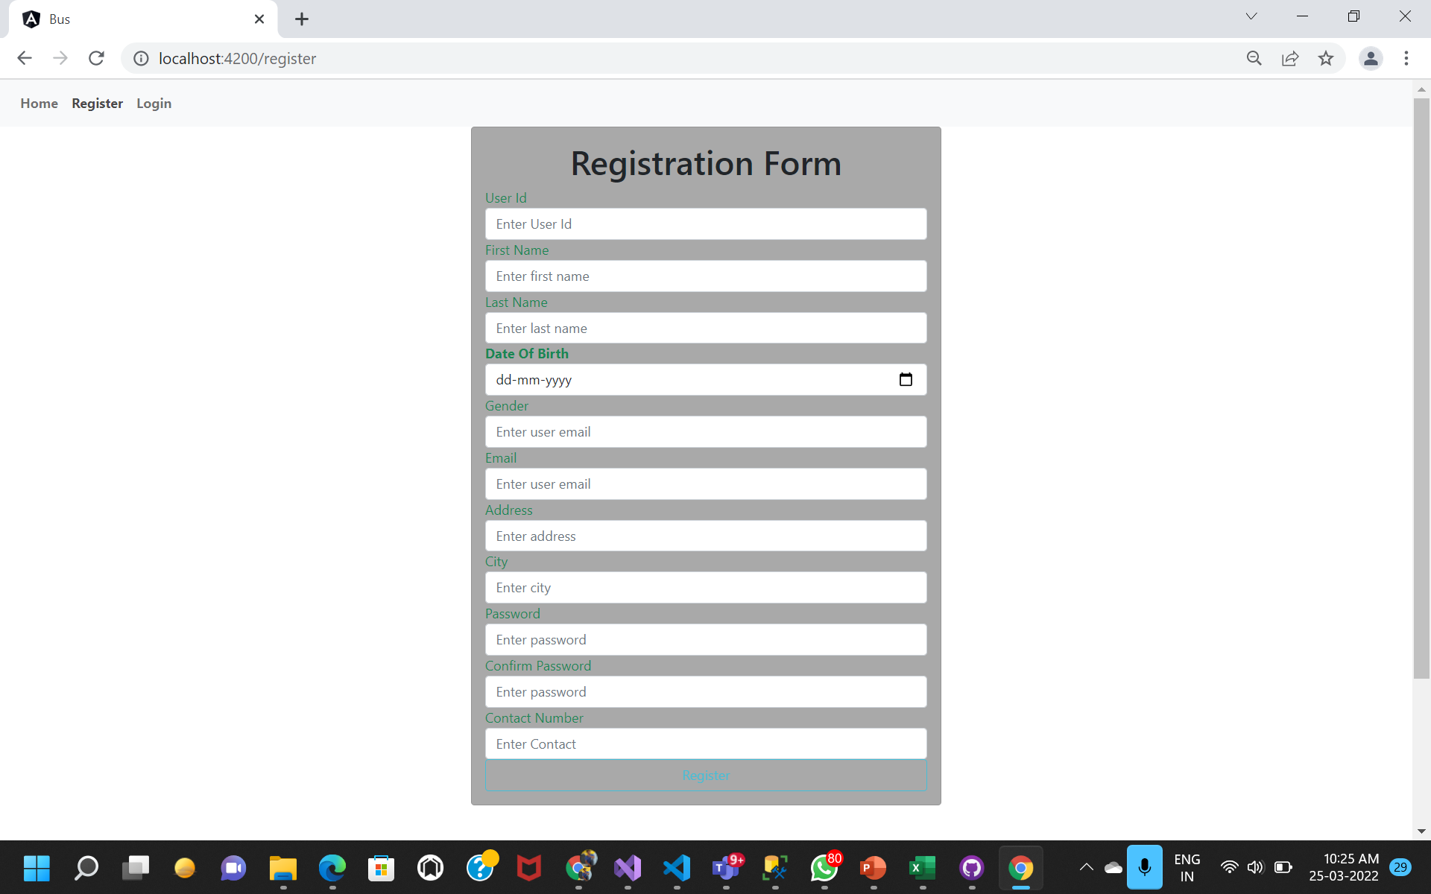

Slide 12
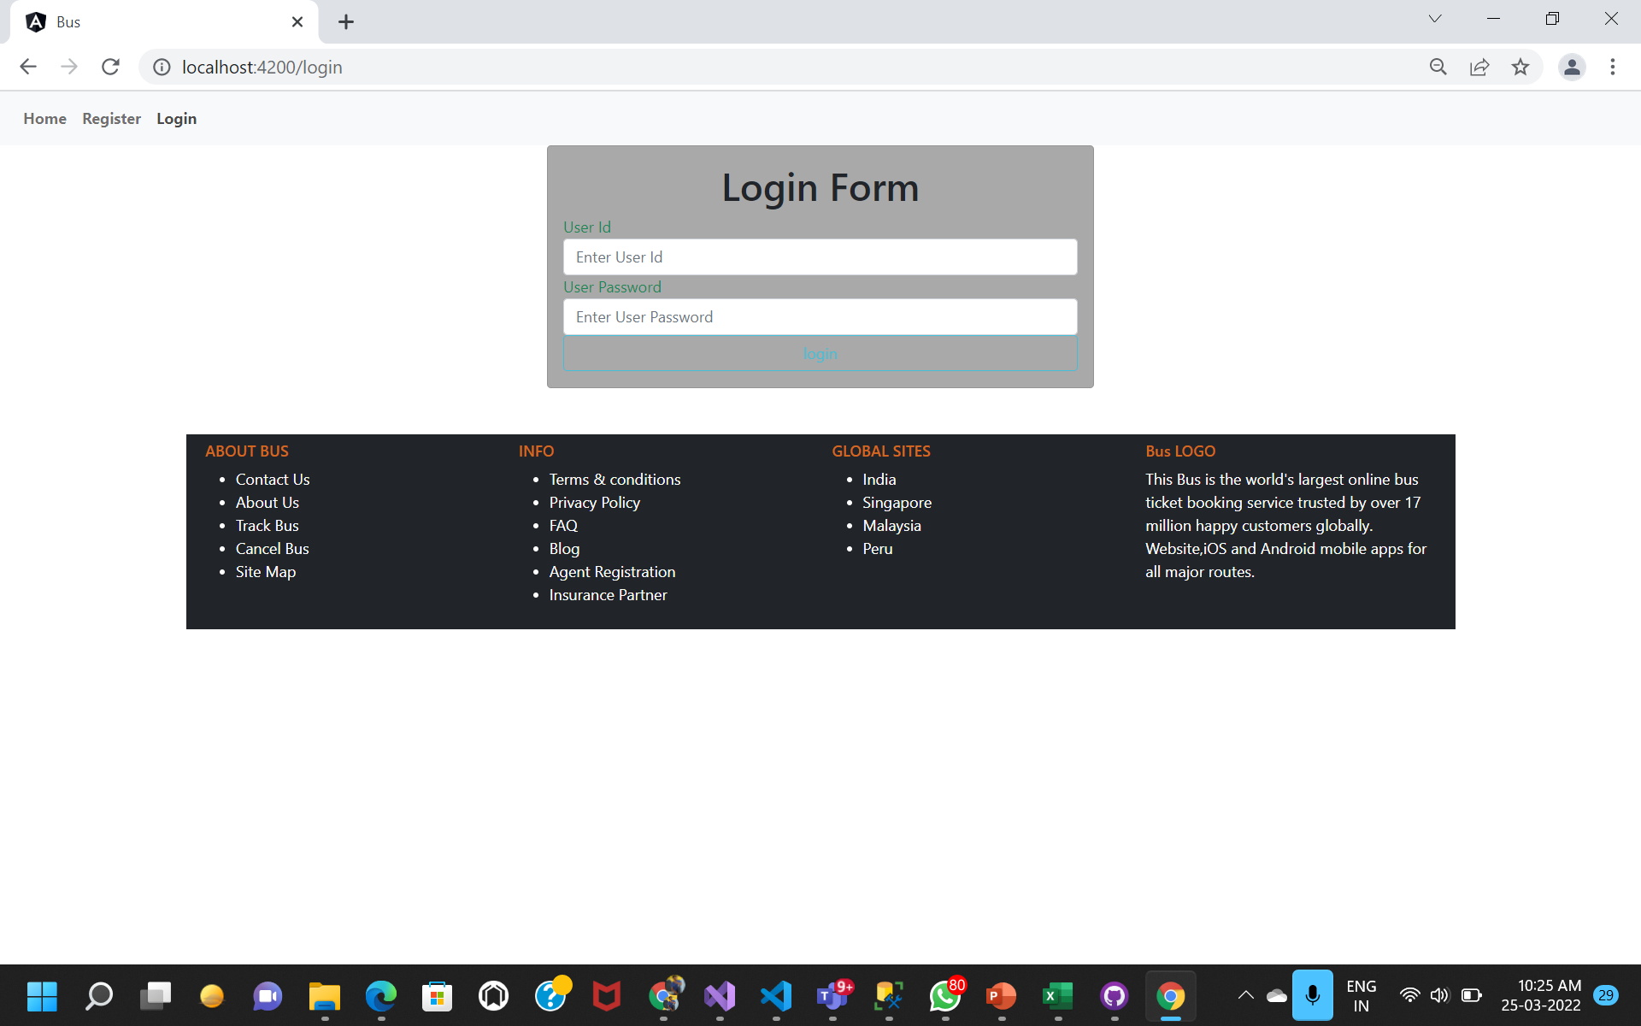

Slide 13
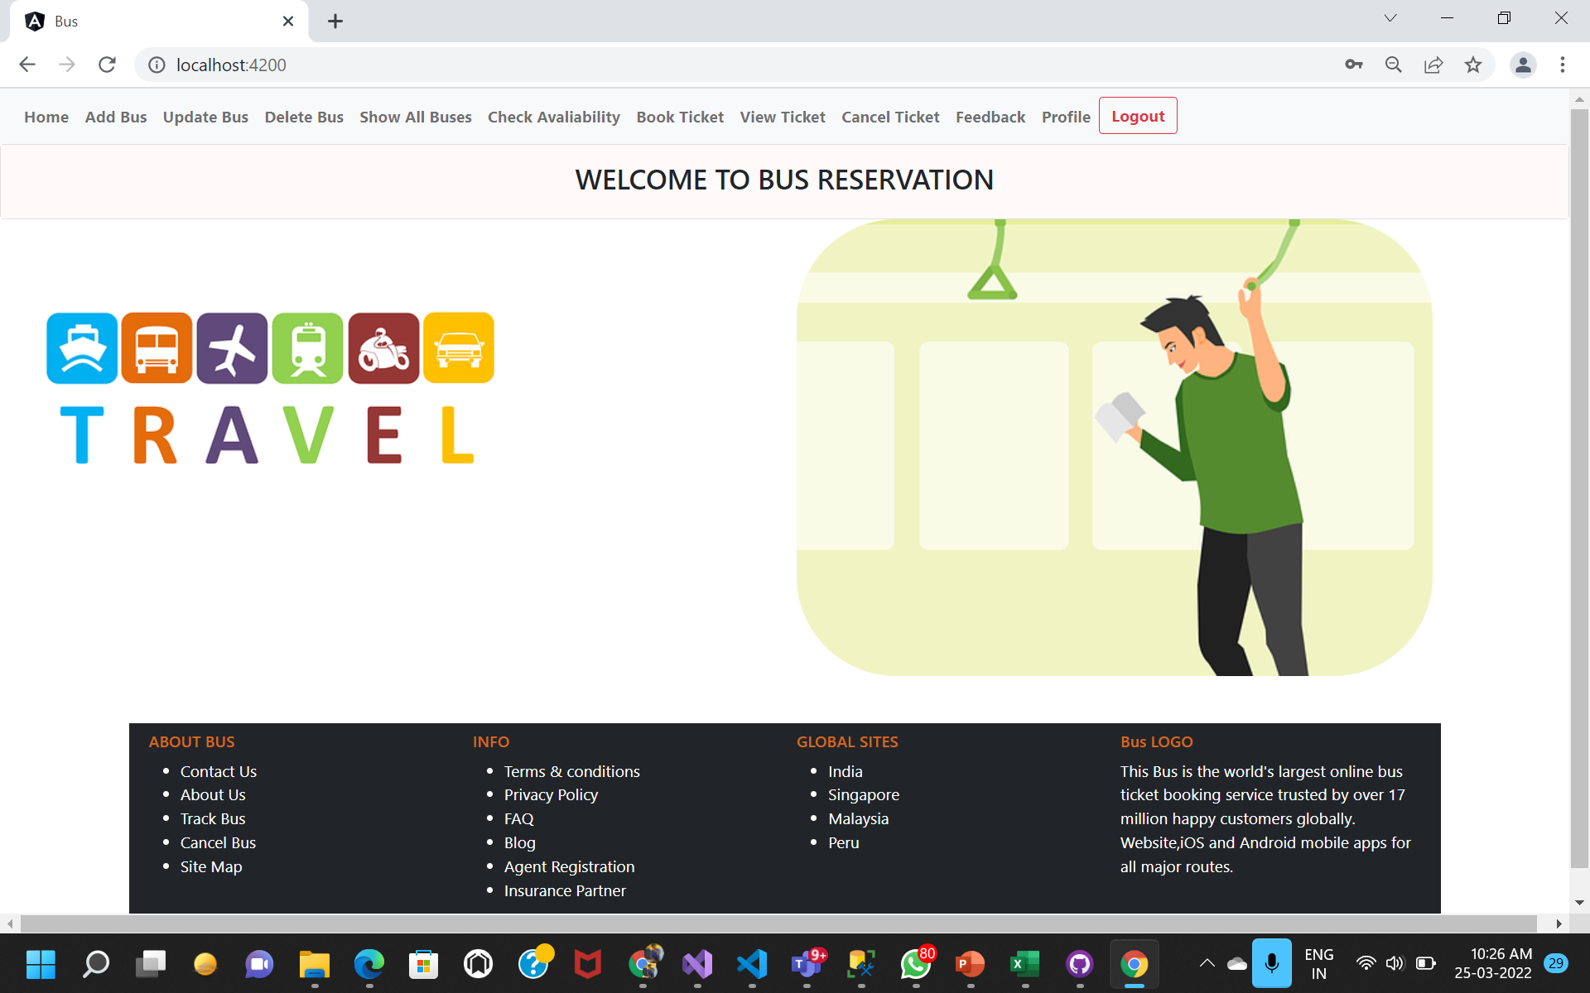

Slide 14
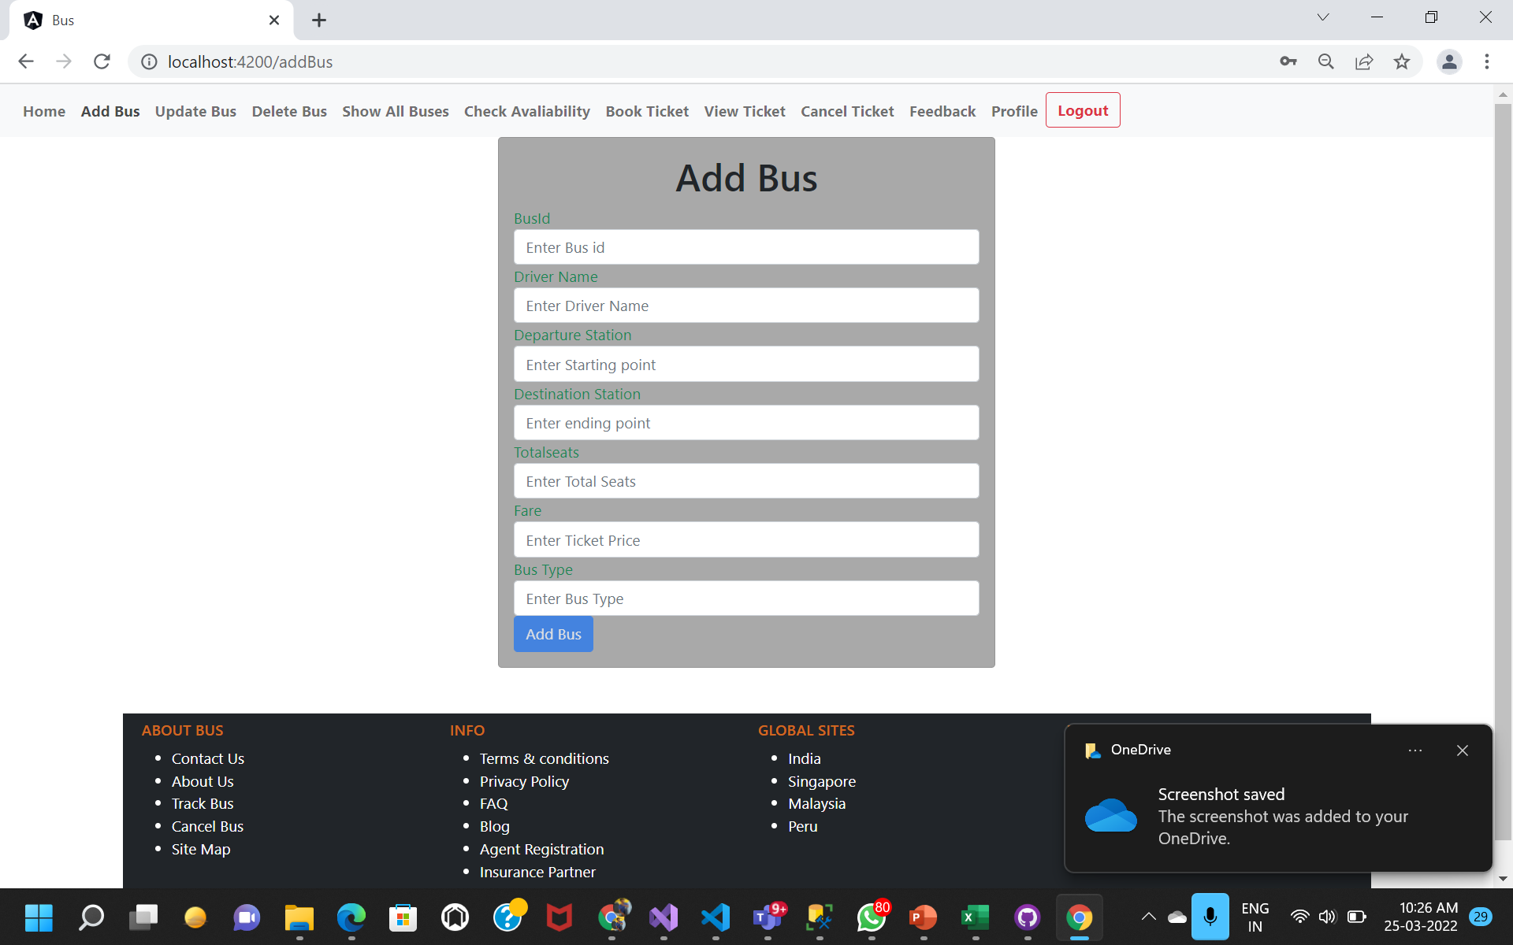

Slide 15
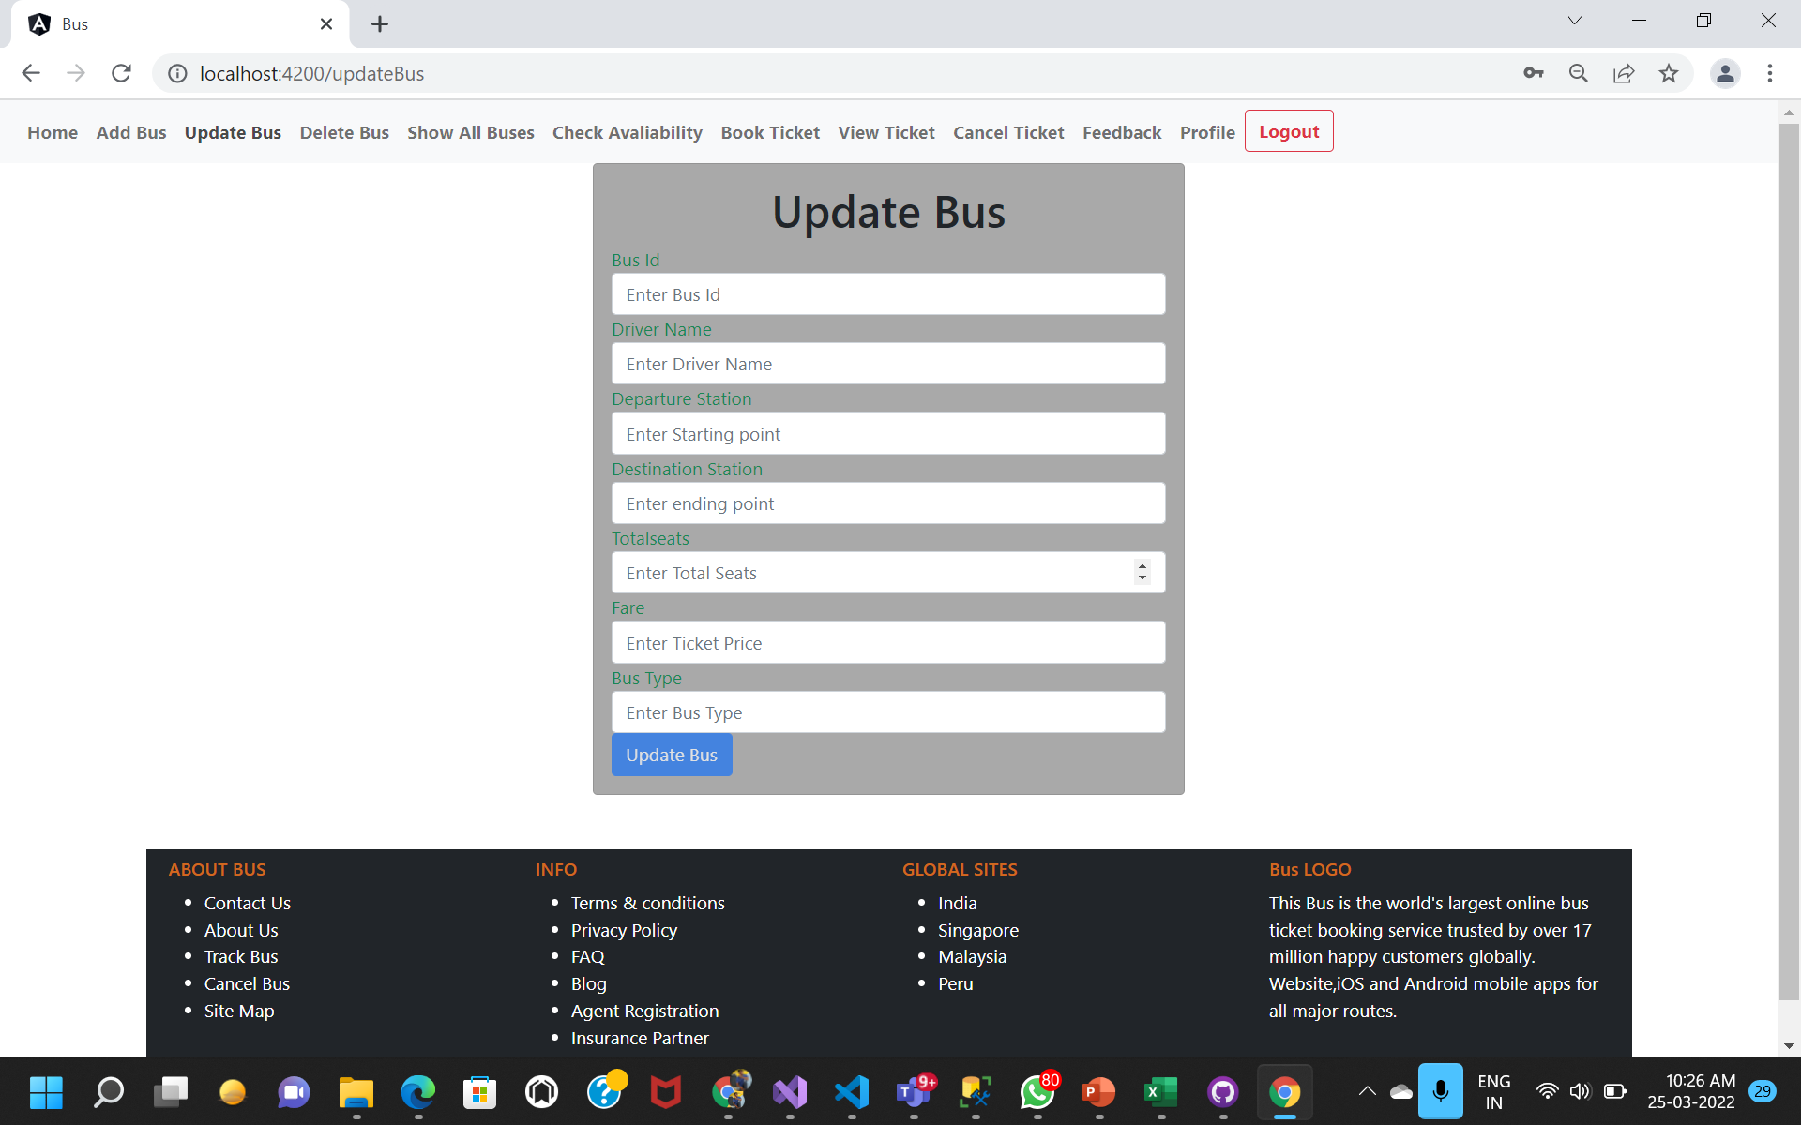

Slide 16
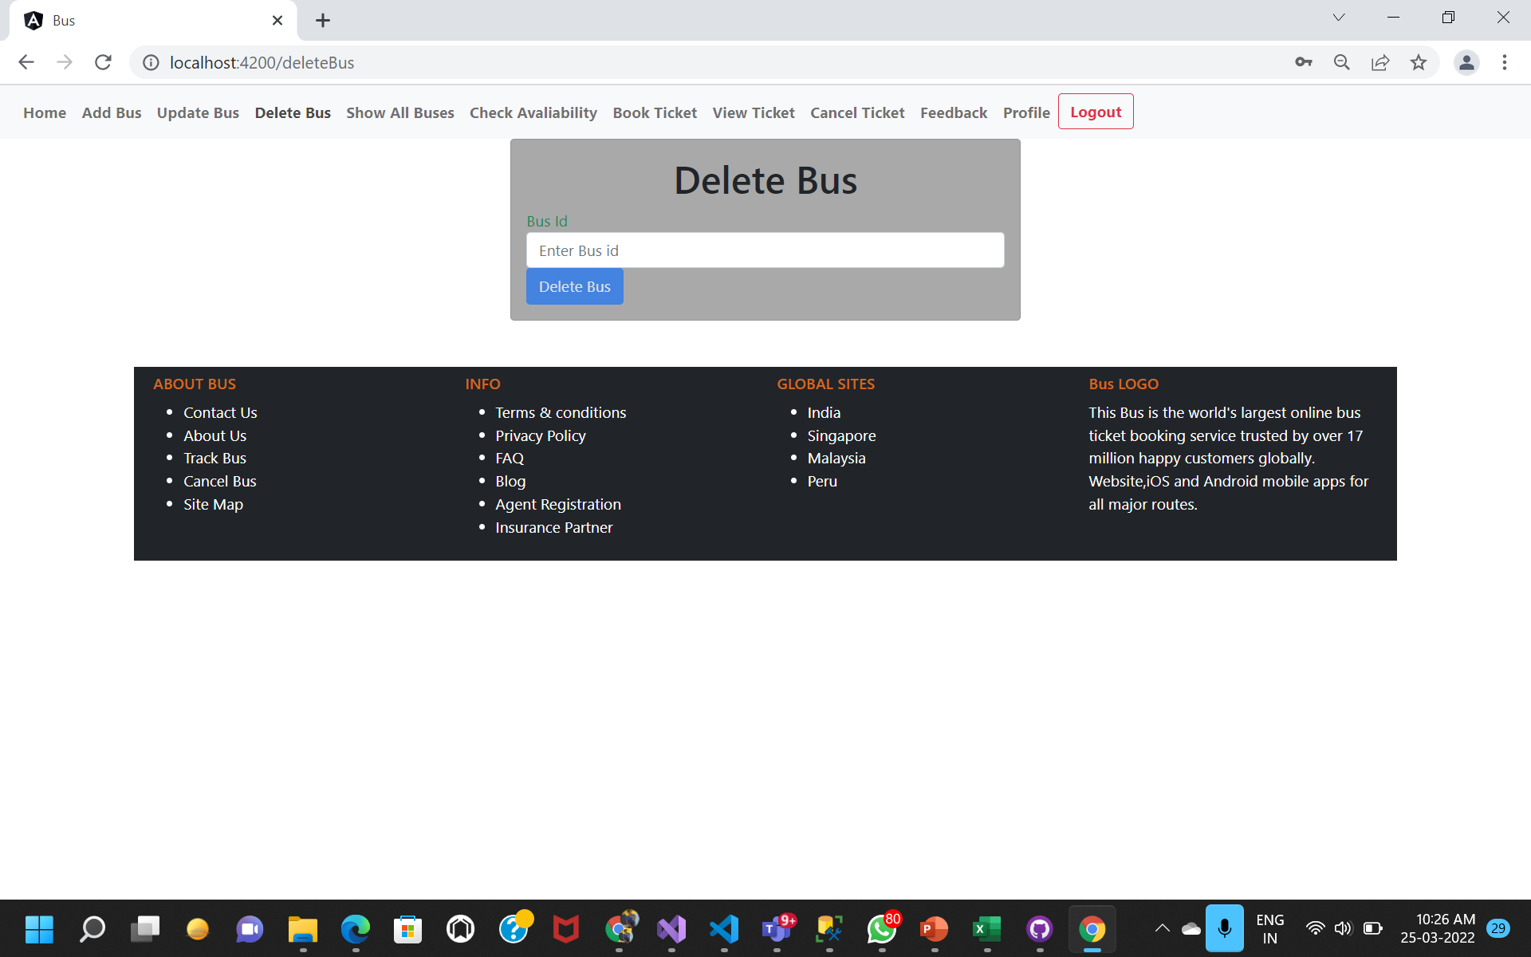

Slide 17
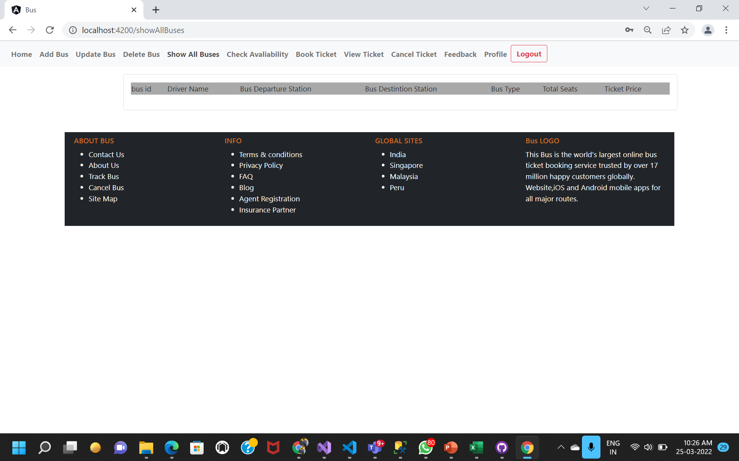

Slide 18
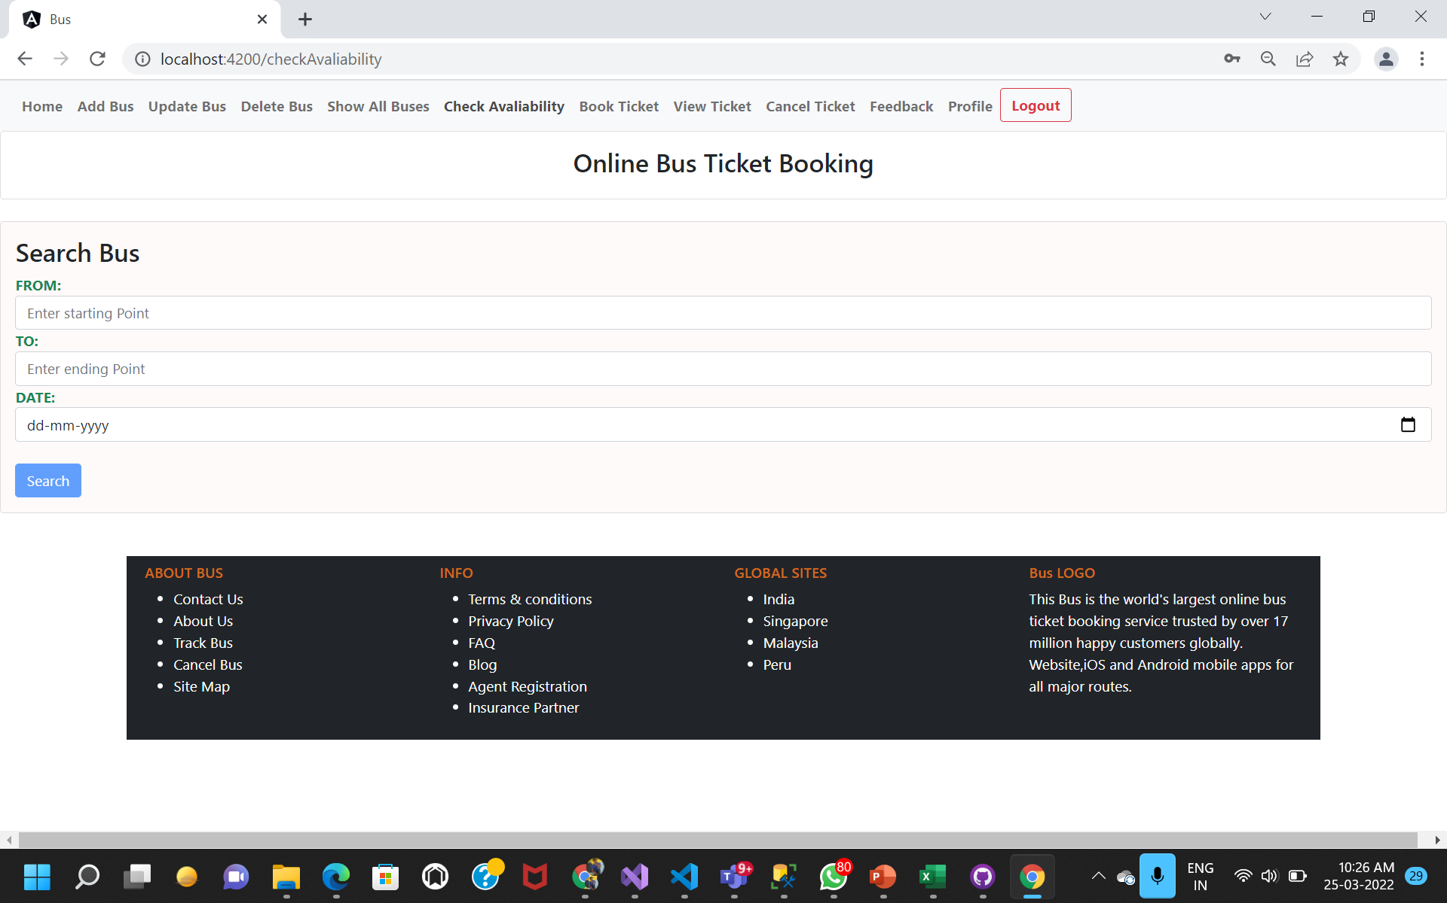

Slide 19
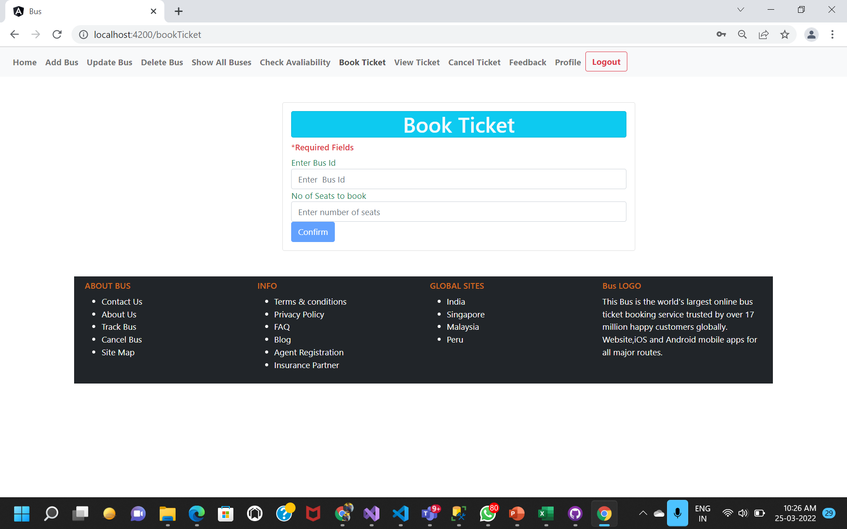

Slide 20
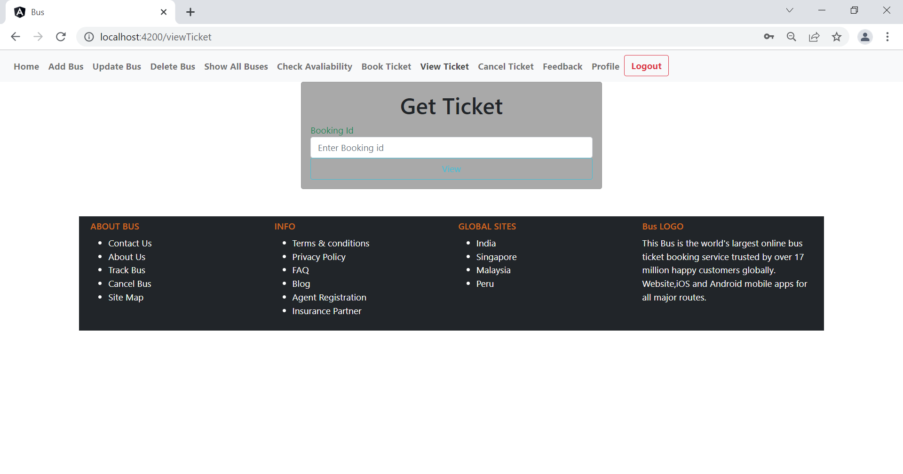

Slide 21


Slide 22
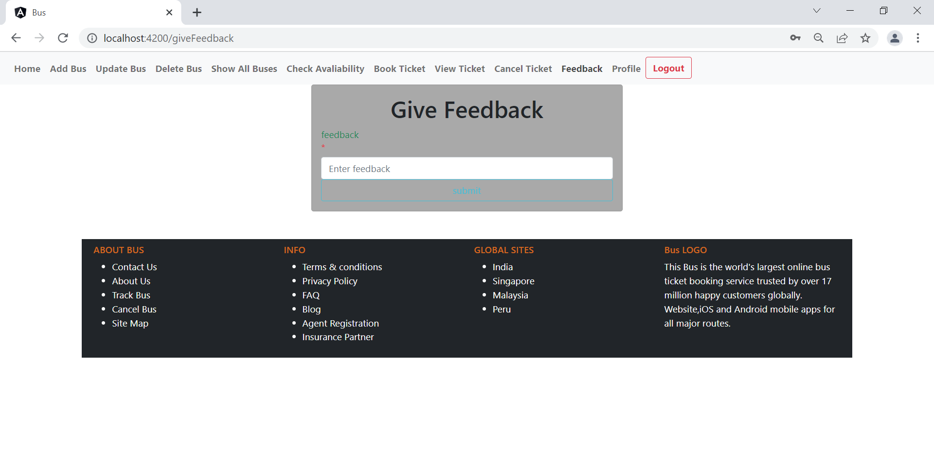

Slide 23
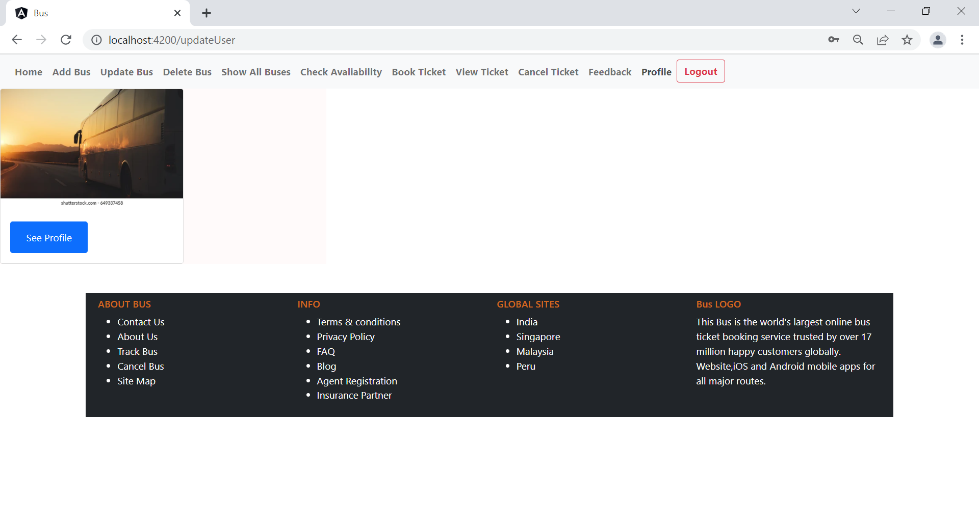

Slide 24
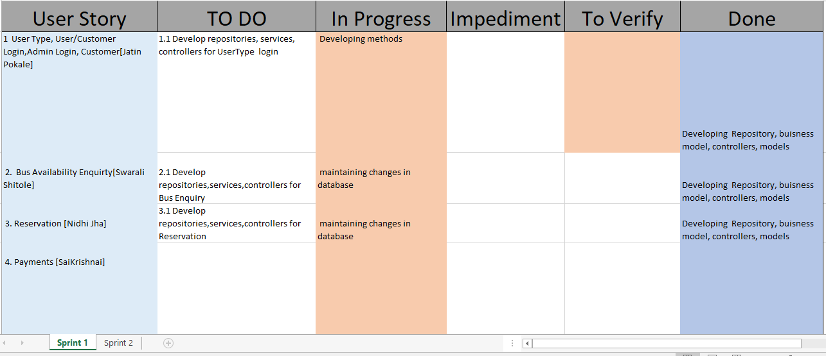
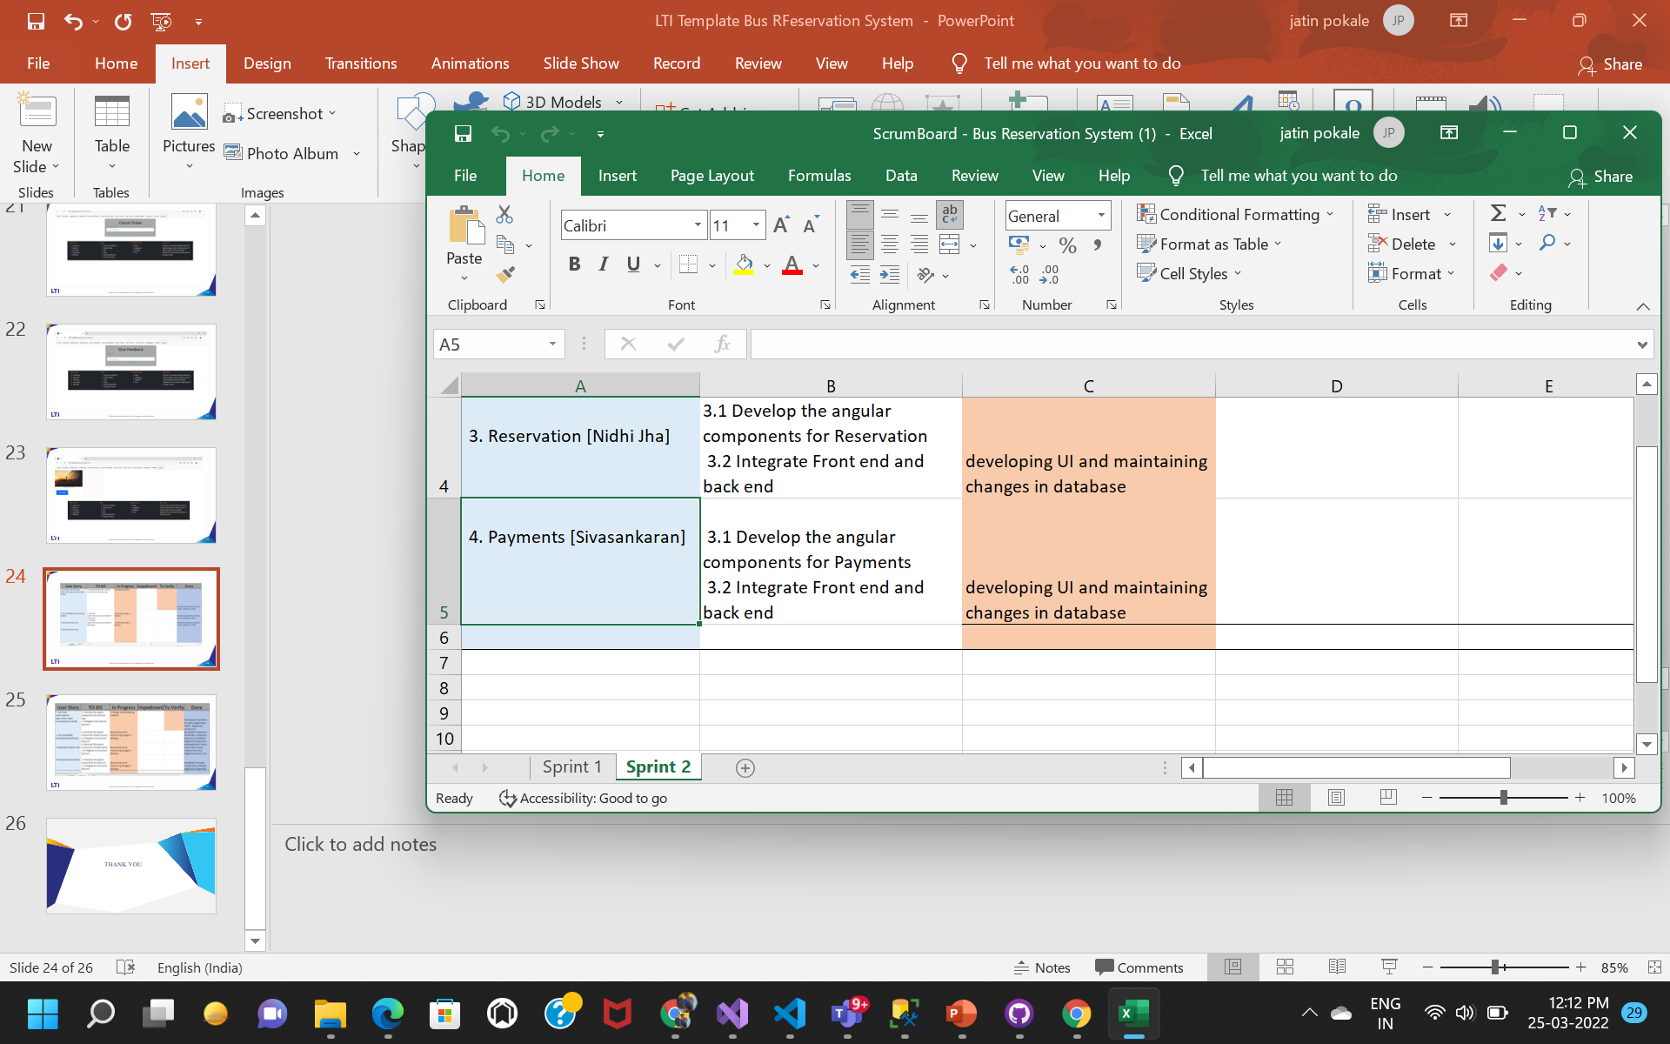

Slide 25
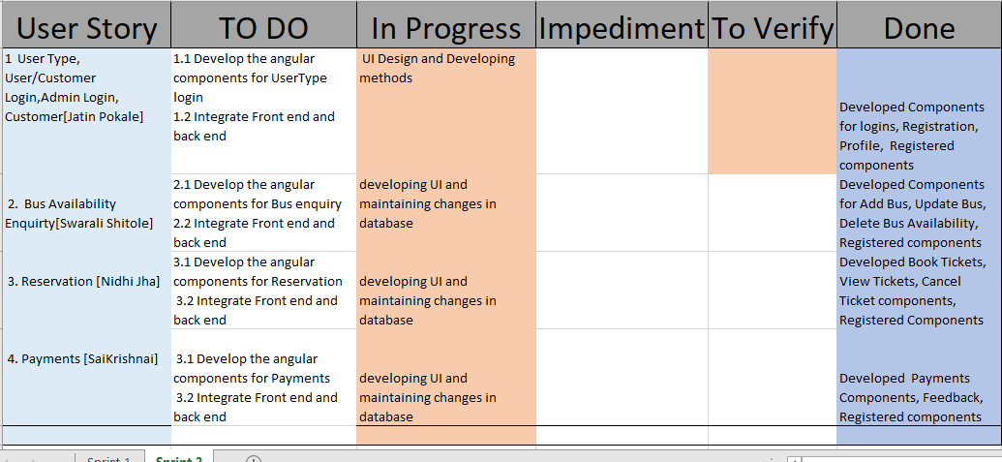

Slide 26
THANK YOU

